Slide 1


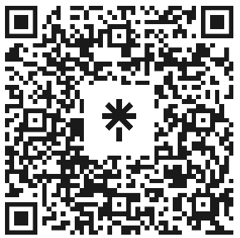

Welcome to Code Crunch!
C8|Crunch Labs: Web Dev
THU 3-4PM Weekly | Spring 2025
Attendance
Earn a Certificate of Completion by attending at least 70% of the workshops
linktr.ee/CODE.CRUNCH

Slide 2
Week #6
Adding Logic to JavaScript Code for Dynamic Web Interactions

Slide 3
Introduction to the Week’s Topic
Overview: This week we will explore how to add logic to your JavaScript code using loops and conditionals. These tools are essential for making web pages interactive and responsive to user actions.
Real-World Relevance:
Loops and conditionals are crucial in real-world web development. They are used for dynamic content generation, form validation, and even for creating interactive user interfaces.
Examples: Shopping carts, quizzes, and dynamic menus all depend on loops and conditionals.

Slide 4
Key Concepts for Today’s Lecture
Concepts Covered:
Loops: for, while, and forEach loops.
Conditionals: if, else, else if, and switch statements.
Real-World Applications: Generating dynamic content with loops and conditionals.

Slide 5
Introduction to Loops in JavaScript
What is a Loop?
A loop allows you to run the same block of code multiple times without repeating it manually.
Use cases: Iterating over arrays, generating lists, or performing repetitive tasks

Slide 6
Types of Loops

Slide 7
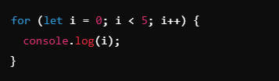
For Loop: A basic loop used when you know how many times you want to iterate.

Slide 8
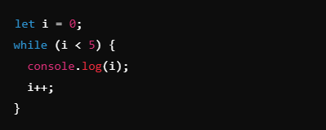
While Loop: Runs as long as a condition is true.

Slide 9
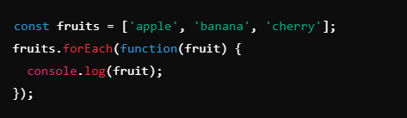
ForEach Loop: Iterates over each item in an array.

Slide 10
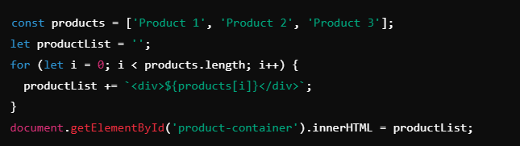
Real-World Examples of Loops
Dynamic Content Generation:
Using loops to generate a list of items dynamically, such as generating product cards in an e-commerce site.

Slide 11
Introduction to Conditionals in JavaScript
What is a Conditional?
A conditional allows you to execute code based on a given condition (true or false).
Use cases: Form validation, showing/hiding content, checking user inputs.

Slide 12
Types of Conditionals

Slide 13
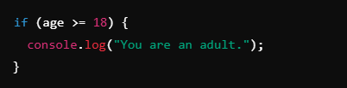
If Statement: Runs code if a condition is true.

Slide 14
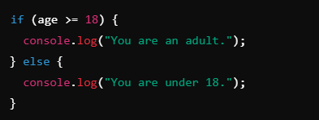
Else Statement: Runs code if the condition is false.

Slide 15
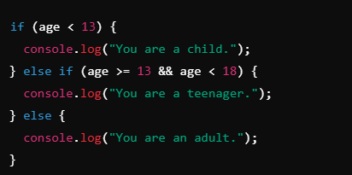
Else If Statement: Used to check multiple conditions.

Slide 16
Real-World Examples of Conditionals
Interactive Features:
Form validation: Checking if all fields are filled before submission.
Dynamic content: Showing different messages based on user inputs or actions.

Slide 17
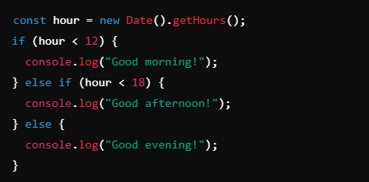
Example: Show a welcome message depending on the time of day.

Slide 18
Combining Loops and Conditionals
Using Loops and Conditionals Together:
Loops can be used to iterate over data, while conditionals can be used inside the loop to make decisions.

Slide 19
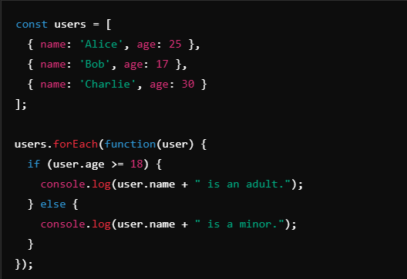
Example: Display a message based on a user’s age in a list of users.

Slide 20
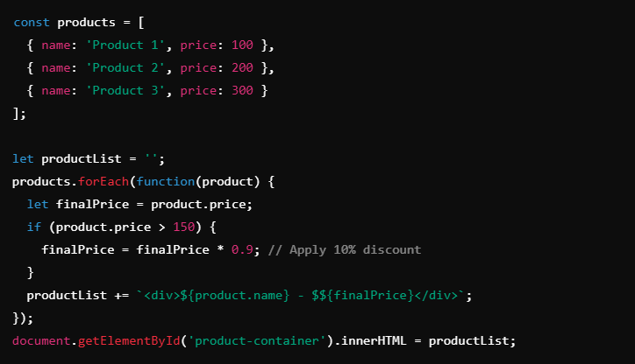
Example: Building a dynamic list of products with prices, and applying discounts to certain products.

Slide 21
Summary of Key Points
Loops: Use loops to automate repetitive tasks, such as iterating over arrays or generating dynamic content.
Conditionals: Use conditionals to add logic to your code, like showing/hiding content or making decisions based on user input.
Combining Loops and Conditionals: These concepts often work together to create dynamic and interactive web pages.

Slide 22
Coding Lab

Slide 23
Introduction to the Coding Lab
Objective: In this lab, we will create dynamic features for a webpage, such as toggling content, calculating values, and using conditionals to interact with users.
Skills Covered:
Using loops to generate content.
Implementing conditionals for dynamic user interaction.

Slide 24
Setting Up the Development Environment
Step 1: Create a new folder and open it in a code editor (e.g., VS Code).
Step 2: Create an index.html file and a script.js file, linking the two in the HTML.

Slide 25
Task 1 - Generating Dynamic Content with Loops
Objective: Create a list of items dynamically using a loop.
Step-by-Step Guide:
Create an array of products.
Use a loop to generate HTML content for each product.
Display the list in a div with the ID product-list.

Slide 26
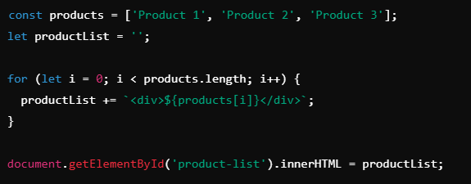

Slide 27
Task 2 - Implementing Conditional Logic
Objective: Create a conditional statement to check if a user is logged in, and display a message accordingly.
Step-by-Step Guide:
Create a boolean variable isLoggedIn.
Use an if statement to display "Welcome back!" if logged in, otherwise display "Please log in".

Slide 28
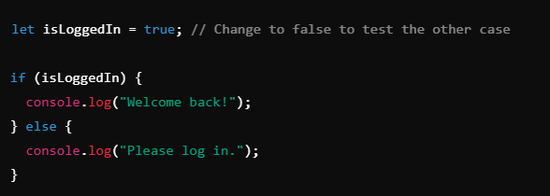

Slide 29
Task 3 - Toggling Content Visibility
Objective: Create a button that toggles the visibility of a paragraph.
Step-by-Step Guide:
Add a button and a paragraph in HTML.
Use JavaScript to toggle the visibility of the paragraph when the button is clicked.

Slide 30

Add a button and a paragraph in HTML.

Slide 31
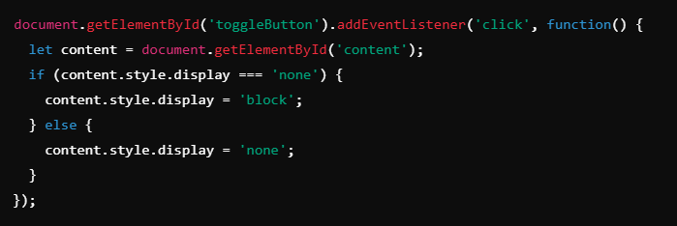
Use JavaScript to toggle the visibility of the paragraph when the button is clicked.

Slide 32
Task 4 - Calculating Values Based on Conditions
Objective: Create a simple calculator that applies a discount if the total price exceeds a certain value.
Step-by-Step Guide:
Create a variable totalPrice.
Apply a 10% discount if the price exceeds $100.

Slide 33
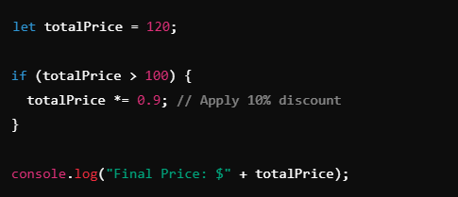

Slide 34
Debugging and Troubleshooting
Common Issues:
Missing semicolons or braces.
Incorrectly defined variables or misspelled variable names.
Logic errors in conditions or loops.
Solution: Use browser Developer Tools to inspect errors and fix issues in the code.

Slide 35
Q & A Session

Slide 36
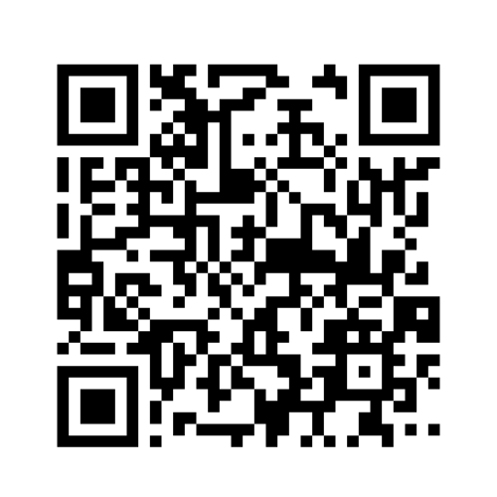
https://github.com/CODE-CRUNCH-CLUB/C8-CRUNCH-LABS-WEB-DEV

Slide 37





Attendance
Join us for the next sessions
Check our schedule on Discord “Schedule” Channel
RSVP lu.ma/CODECRUNCH
Your feedback helps us improve. Share your thoughts! Go to our website: go.fiu.edu/codecrunch
linktr.ee/CODE.CRUNCH

